Slide 1
Credit Card Fraud Detection
Deep Savla (W1652329)
Jash Shah (W1650179)

Slide 2
Index
Abstract
Data
Models
Approach
Algorithm
Conclusion

Slide 3
Abstract
With the increase in cashless transactions, security has become a major concern. Credit card frauds have increased and have become the most common financial frauds. Credit card fraud is a king of identity theft where the fraudsters gain access to your account and can use it to make purchases.
We employed logistic regression, a widely used technique for classifying binary data, in this project to identify fraudulent transactions.
Data contains the following parameters:
Time (Seconds between the current transaction and first transaction)
Transaction amount
Class (0 for normal transactions, 1 for fraudulent transactions)
V1-V28 (Result of PCA dimensionality reduction)
Dataset

Slide 4
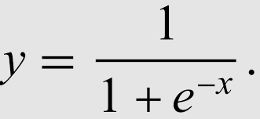
Models
Logistic Regression:
It is a binary classification approach used to determine whether or not a transaction is fraudulent.
It employs sigmoid function, which accepts a real input x and predicts an output probability ranging from 0 to 1.
If P(x) is more than 50%, then output Y = 1.
The LR model's test accuracy for our project is 90.36%.
Support Vector Machines:
The goal of the support vector machine technique is to find a hyperplane in an N-dimensional space (N — the number of characteristics) that clearly classifies the input points.
For our project, the test accuracy of the SVM model is 89.85%.
K- Nearest neighbor:
The k-nearest neighbors algorithm, often known as KNN or k-NN, is a non-parametric, supervised learning classifier that employs proximity to create classifications or predictions about an individual data point's grouping.
The distance is calculated using the Euclidean, Manhattan, and Minkowski approaches.
For our KNN classification, we use the Euclidean algorithm d=((x2-x1)^2+(y2-y1))^2) The KNN model's test accuracy for our project is 62.94%.

Slide 5
Approach taken
Data Collection
Data Pre-processing
Logistic Regression
Fetch Datasets from the relevant locations
Balancing the data and data splitting
Training the model for logistic regression
Comparing Models
Support Vector Machine
K-Nearest-
Neighbour
Confusion Matrix
Applying SVM algorithm on the dataset
Applying KNN algorithm on the dataset.

Slide 6
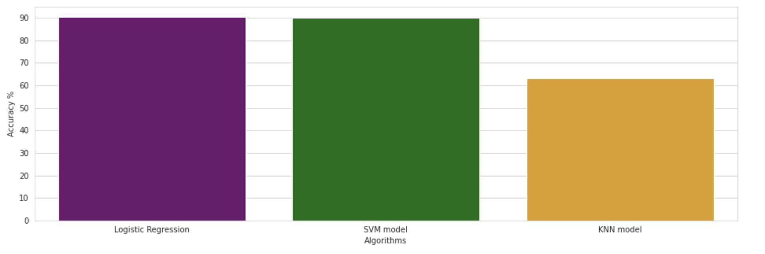
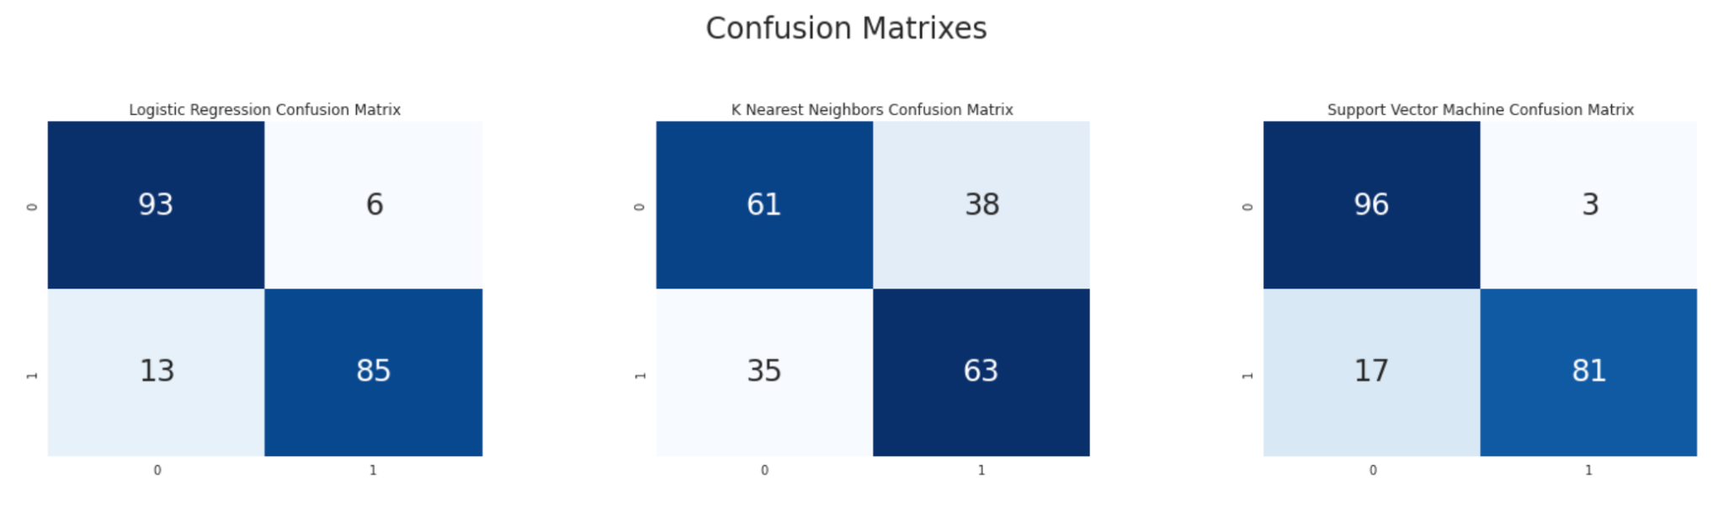
Algorithms

Slide 7
Conclusion
After the comparison of the three techniques it was observed that the best accuracy was provided by Logistic Regression.
The accuracy in this case was found to be 90%.
Hence it can be concluded that by using Logistic Regression we can stop fraudsters from getting access to the user’s personal information of other data present in the account.

